Slide 1

Humber
Admission
System

Slide 2
Overview
Approach
IPO Methodology
Testing and Demo

Slide 3
Approach

Slide 4
Objective
The system should store information about the newly admitted students and assign them to schools according to their GPA.
The system must prompt the user to enter the name of each student, and the grades of the courses they completed in the high school.
Then, the system should calculate the GPA and use it to assign students the schools.

Slide 5
Feature Overview
Ask the user’s password and check it
Ask the user the number of students and check if the number is in range
Ask the user the names of students and their corresponding grades
Program will automatically compute GPA of each student and assign a school
Print reports about the admission results

Slide 6
IPO Methodology

Slide 7
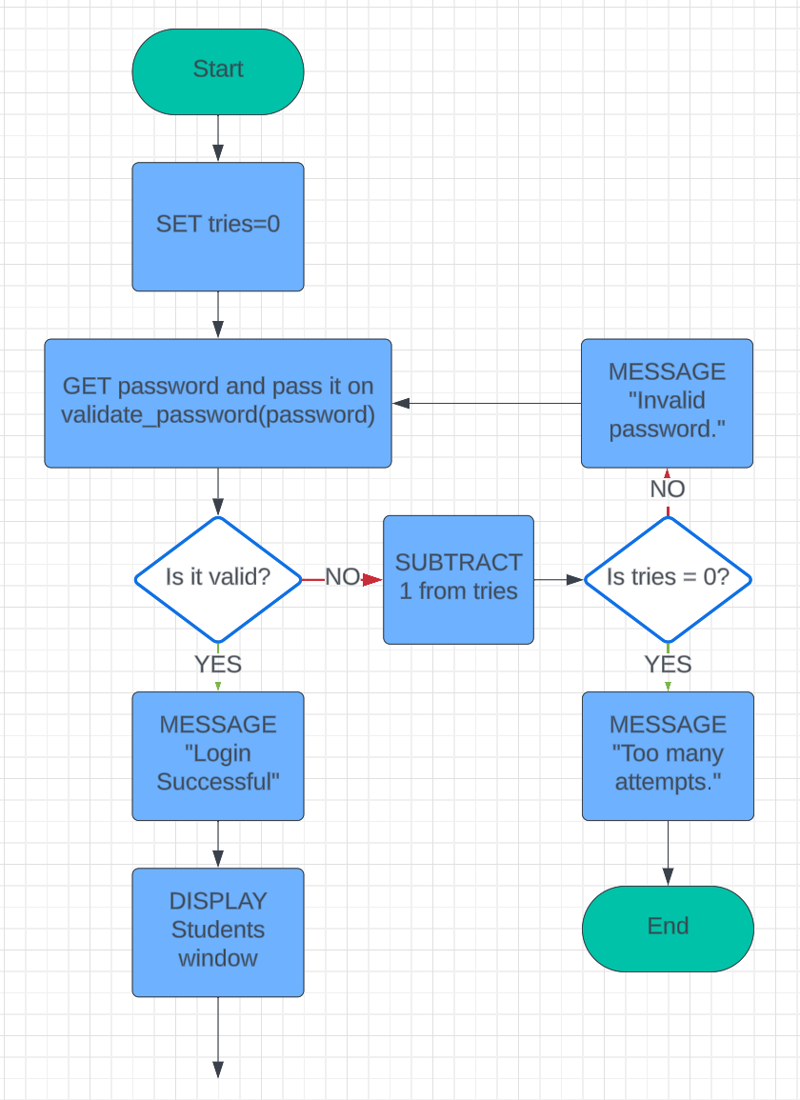
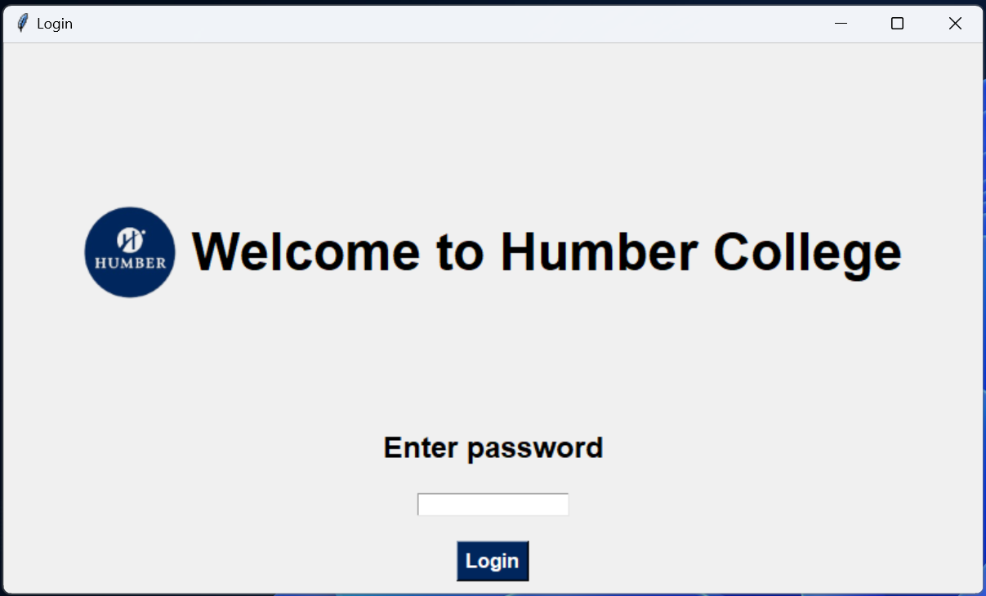
Login Window
This window asks the user’s password and checks it against the first constraint (slide 12)
Window will exit after three incorrect password attempts.

Slide 8
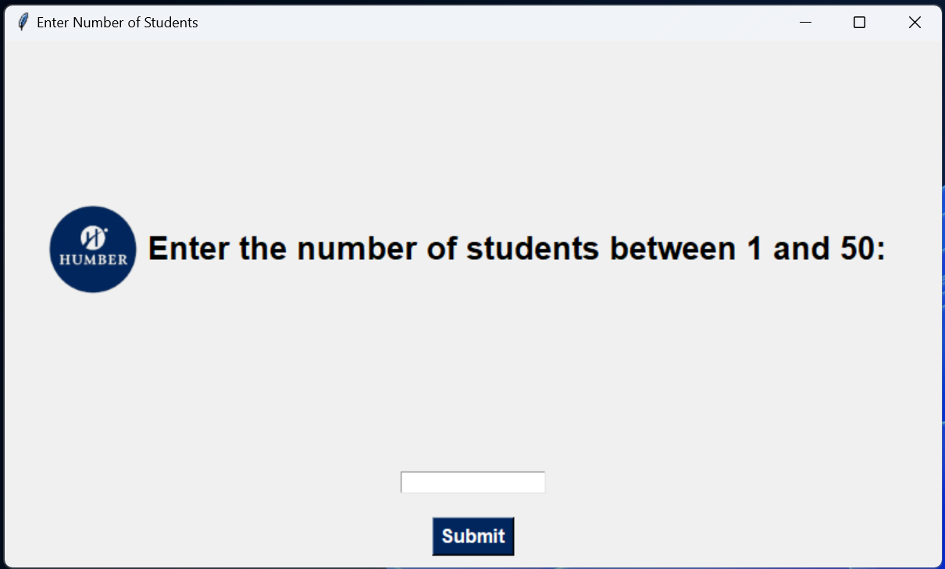
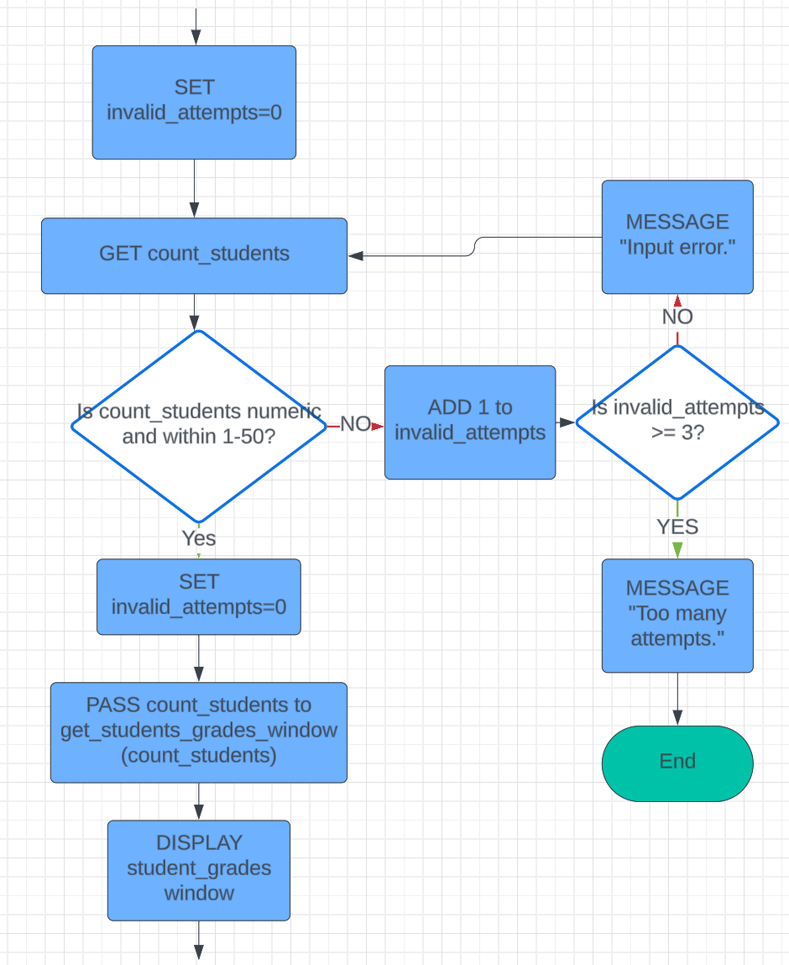
Students Window
This window asks how many students the user will enter grades for.
Program will check input against the second constraint (slide 12) and will exit after three invalid attempts.

Slide 9
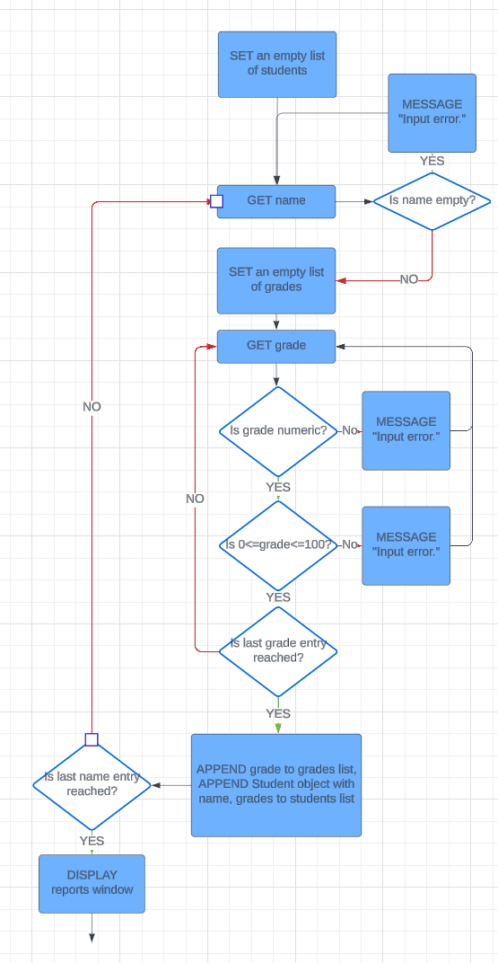
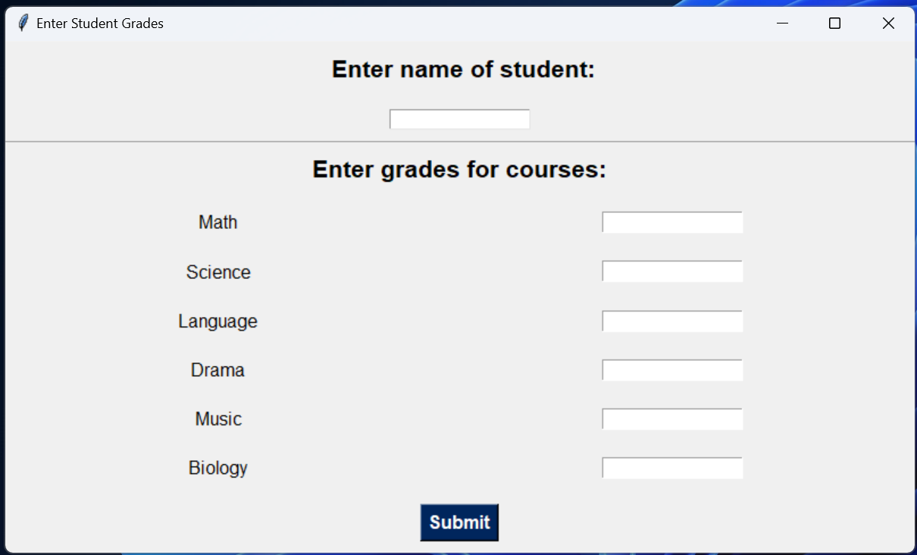
Student Grades Window
This window will ask the user to enter the name and grade of the student.
The system will repeat the process until it reaches the total number of students submitted in the previous window.
Notes:
What is the purpose?
What it will check?
How will it loop?
What comes next?

Slide 10
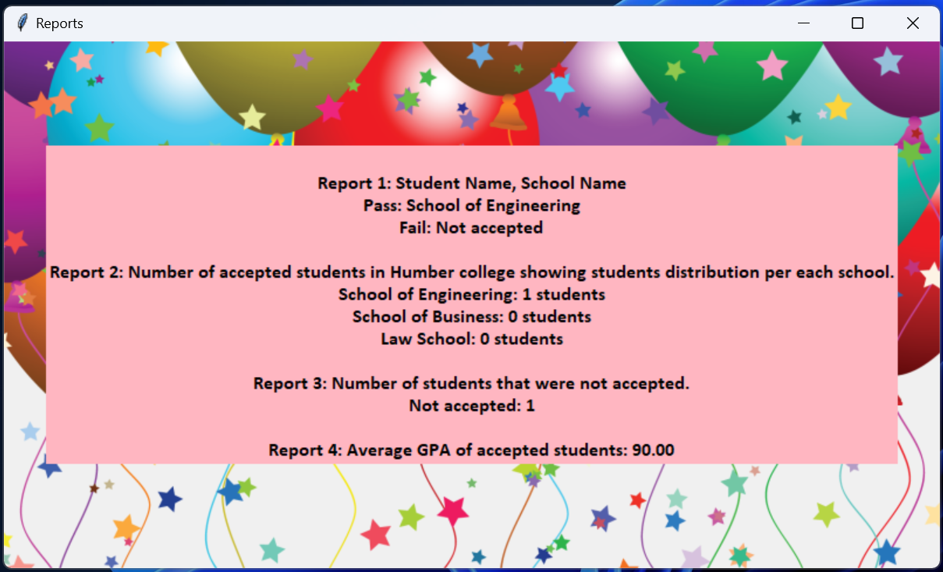
Reports Window
Based on the data submitted in the last window and the computed GPA, the system generates and displays the following four reports:
Student Name and School Name
Number of accepted students in Humber per each school
Number of students that were not accepted
Average GPA of those accepted students

Slide 11
Testing

Slide 12
Constraints
Password must satisfy the following rules:
Should not be less than 10 characters
Should contain at least one upper case letter
Should contain two or three numbers
Should contain one special character
The number of students entered must be between 1-50

Slide 13
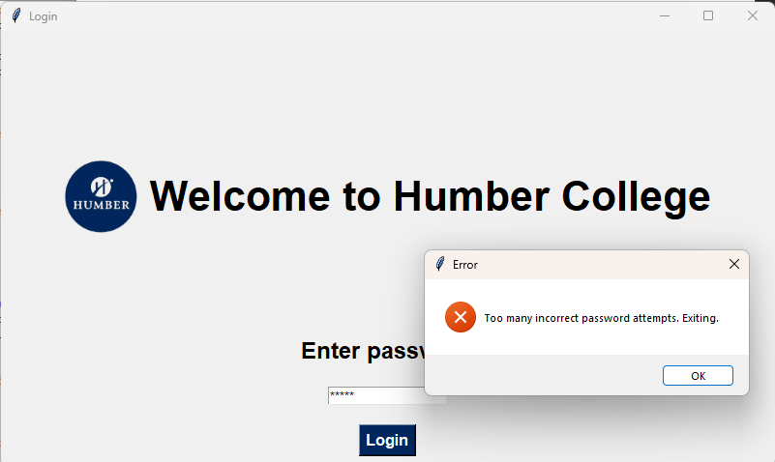
Test Cases

Slide 14
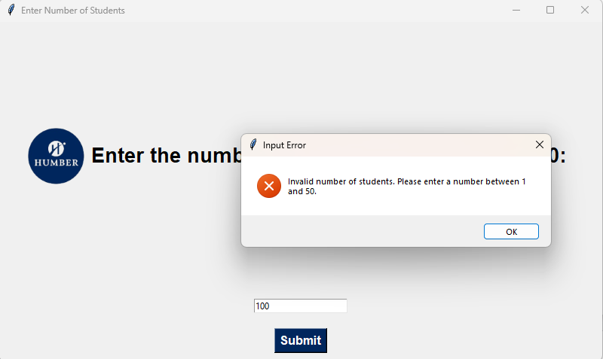
Test Cases

Slide 15
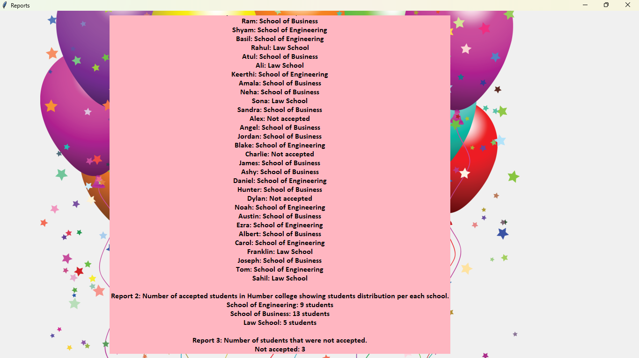
Report

Slide 16
Demo

Slide 17
Thank you.

